Slide 1
Digital Portfolio
STUDENT NAME: Rudhira kumar.A
REGISTER NO AND NMID: 20324u48026 & F5ED0AA39778CCE801A4BE7A7C042162
DEPARTMENT: Bsc Data science
COLLEGE: DR.M.G.R.CHOCHALINGAM ARTS COLLEGE / THIRUVALLUVAR UNIVERSITY

Slide 2
PROJECT TITLE
Digital Portfolio Website Using HTML, CSS & JavaScript
A responsive and interactive personal website designed to
showcase my skills, projects, and learning journey in web development.

Slide 3


AGENDA
Problem Statement
Project Overview
End Users
Tools and Technologies
Portfolio design and Layout
Features and Functionality
Results and Screenshots
Conclusion
Github Link
3/21/2024 Annual Review

Slide 4

PROBLEM STATEMENT
In today's competitive digital world, having an online presence is essential for students and developers. Traditional resumes are static and lack interactivity. I wanted a dynamic, easily accessible, and visually appealing way to showcase my skills and projects.
Challenges Identified: Lack of an interactive platform to showcase personal
skills and projects Difficulty in sharing project work with potential employers
or collaborators

Slide 5

PROJECT OVERVIEW :
This project is a personal digital portfolio website developed using HTML, CSS, and JavaScript. It acts as a digital resume and project showcase. Key Sections: 👉Hero section with introduction and CTА 👉About Me 👉Skills display 👉Projects gallery 👉Contact form
Objectives: 👉Display web development skills in real-time 👉Practice responsive design and interactivity 👉Create a professional online identity

Slide 6

WHO ARE THE END USERS?
👉primary Target Users👈 1. Hiring Managers & Recruiters: Can view my skills, resume, and projects in a single place 2. Teachers/Mentors: To assess my learning progress and project application 3. Peers & Collaborators: For networking, feedback, and collaborations 4. General Public: Anyone interested in viewing my work or learning from my journey

Slide 7

TOOLS AND TECHNIQUES
Languages & Tools Used: 👉HTML5 - Structure of the website 👉CSS3 - Styling, layout, animations 👉JavaScript (Vanilla) - Interactivity and form validation 👉Codepen- Code editor 👉GitHub (optional) - Version control and hosting - 👉Google Fonts (optional) - Typography enhancer↓

Slide 8
POTFOLIO DESIGN AND LAYOUT
The design focuses on simplicity, responsiveness, and clean navigation. 👉 Key Design Choices👈 👉🏻Navigation Bar: Fixed, responsive, toggles on mobile view 👉🏻Hero Banner: Gradient background, CTA button 👉🏻Skills Section: Flex/grid layout with hover animations 👉🏻Projects Section: Grid of project cards 👉🏻Contact Section: Simple form with inputvalidation 👉🏻Color Palette: Blue, gray, white, yellow 👉🏻Typography: Clean and readable sans-serif fonts
8

Slide 9
FEATURES AND FUNCTIONALITY
Core Features: 👉Responsive layout across all devices 👉Smooth scroll navigation 👉Interactive skill badges and project cards 👉Contact form with basic validation 👉Hover effects and transitions for better UI/UX Functional Highlights: 👉Mobile Navigation Toggle - Menu collapses into a hamburger icon 👉Form Validation - JavaScript checks that all field filled 👉Project Cards - Hover animations and individual descriptions 👉Consistent Layout - Sections separated clearly with padding and headers

Slide 10

RESULTS AND SCREENSHOTS
Outcome:
A fully functional, visually appealing personal website
Hosted and ready to be shared with others
Demonstrates key front-end development skills
(Insert screenshots of each section here: Hero, About, Skills, Projects, Contact)
Measurable Results:
Mobile responsive tested across devices
Valid HTML and CSS syntax
Functional JavaScript form logic
Improved understanding of layout and user interaction
3/21/2024 Annual Review
10

Slide 11
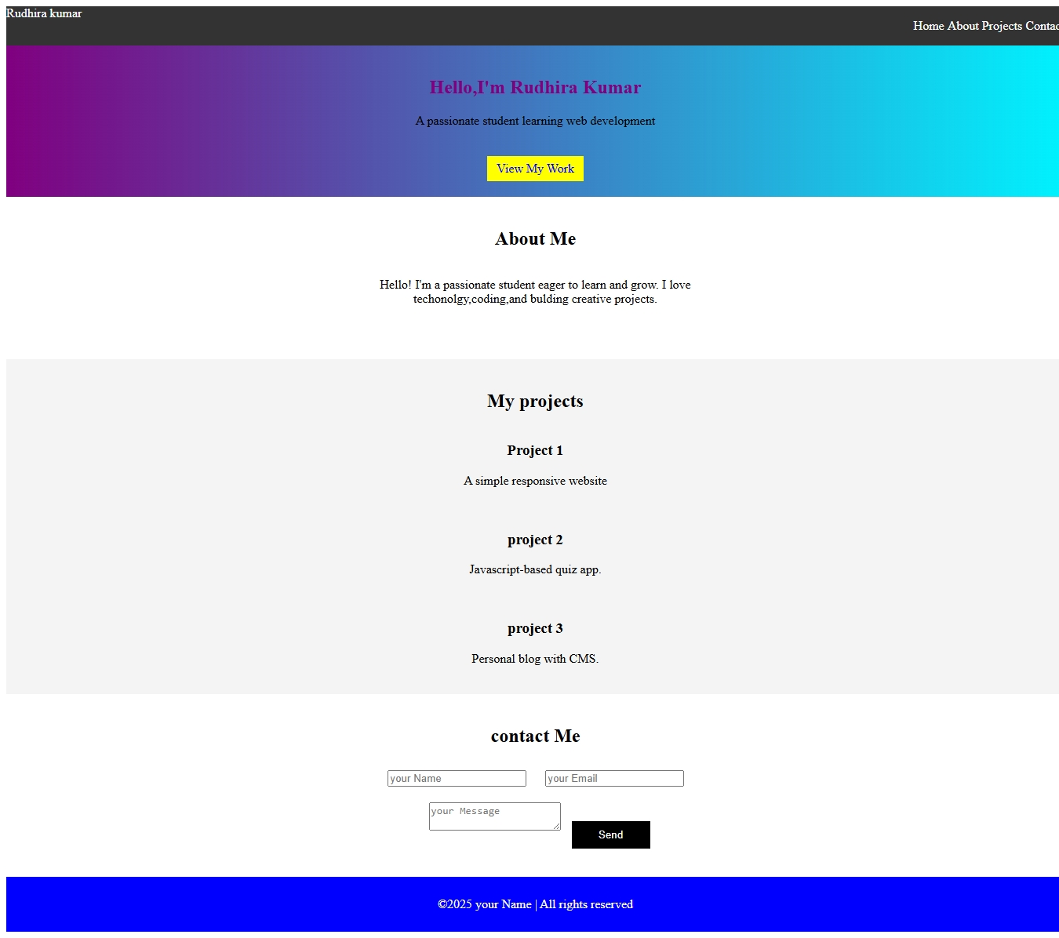

Slide 12
CONCLUSION
This digital portfolio has not only provided a platform to showcase my work but also served as a hands-on learning experience in web development.
12

